Slide 1
TELUS SOW SUMMARIZATION
Yasamin abbaszadegan
Zonair Nadeem

Slide 2
Agenda
1- Problem Statement
2- Data SOW’s Analysis
3- Summarization Techniques
Extractive
Abstractive
4- Results
5- Discussion

Slide 3
Problem Statement
In this project, you will be given several Statement of Work (SoWs) documents from TELUS which will be used for training/developing and testing purposes of this project. The SoW is the document that captures and defines all aspects of the project. It includes all the deliverables and the timetable for the project and is an extremely detailed document which lays the foundation for the project plan. This use case requires you to develop a NLP model to produce a summary of the SOW documents in roughly 200 to 400 words.

Slide 4
Corpus Preparation
Preprocessing of Corpus:
Text cleaning.
Total 14 Sections:
Description, Definition, Services, Term and Schedule, Place of performance and hours, Structure and Roles, General Responsibilities, Charges Expenses and Payment terms, Specific Service levels, Reports, Assumption and additional provisions, Addresses for Administration and invoicing, Agreement, Appendix ‘A’, Appendix ‘B’.
Extracted Sections based on best Results:
Services, Term and Schedule, Place of performance and hours, Structure and Roles, General Responsibilities, Charges Expenses and Payment terms, Assumption and additional provisions, Agreement.

Slide 5
Summarization Techniques: Used:
Extractive Summarization(TFidf, TextRank, LSA):
The extractive approach involves picking up the most important phrases and lines from the documents. It then combines all the important lines to create the summary. So, in this case, every line and word of the summary actually belongs to the original document which is summarized.
Abstractive Summarization(T5 Small, Bart):
The abstractive approach involves summarization based on deep learning. So, it uses new phrases and terms, different from the actual document, keeping the points the same, just like how we actually summarize. So, it is much harder than the extractive approach.

Slide 6
TF-IDF Summarization
TF-IDF: A High weight in TF-IDF is reached by a high term frequency(in the given document) and a low document frequency of the term in the whole collection of documents.
Reference link:
https://towardsdatascience.com/text-summarization-using-tf-idf-e64a0644ace3

Slide 7
TF-IDF Summarization
TF = Term Frequency:
TF(t) = (Number of times term t appears in a sentence) / (Total number of terms in the sentence)
IDF = Inverse Document Frequency:
IDF(t) = log_e(Total number of sentences / Number of sentences with term t in it)
Example: Consider a sentence containing 10 words wherein the word apple appears once in it. The term frequency (i.e., TF) for apple is then (1 / 10) = 0.1. Now, assume we have 1,000 sentences and the word apple appears in 10 of these. Then, the inverse document frequency (i.e., IDF) is calculated as log(1,000 / 10) = 2.Thus, the TF-IDF weight is the product of these quantities: 0.1 * 2 = 0.2.
We do this for all the words in the document, and then evaluate the importance of each sentence on sum of the TF-IDF score of the words in it.

Slide 8
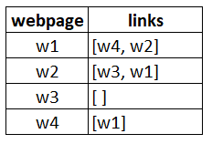
TextRank Summarization
Reference link:
https://medium.com/data-science-in-your-pocket/text-summarization-using-textrank-in-nlp-4bce52c5b390
TextRank finds its roots associated with Google’s PageRank (by Larry Page) used for ranking webpages for online search results. But before unfolding TextRank, we must understand PageRank & the intuition behind it:
PageRank:
PageRank is used primarily for ranking web pages in online search results.
Suppose we have 4 web pages — w1, w2, w3, and
w4. These pages contain links pointing to one
another. Some pages might have no link – these
are called dangling pages.
In order to rank these pages, we would have to
compute a score called the PageRank score.
This score is the probability of a user visiting that
page.

Slide 9
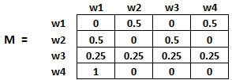
PageRank(Cont’)
The initialization of the probabilities is explained in the steps below:
Probability of going from page i to j, i.e., M[ i ][ j ], is initialized with 1/(number of unique links in web page wi)
If there is no link between the page i and j, then the probability will be initialized with 0
If a user has landed on a dangling page, then it is assumed that he is equally likely to transition to any page. Hence, M[ i ][ j ] will be initialized with 1/(number of web pages)
Hence, in our case, the matrix M will be initialized as follows:

Slide 10
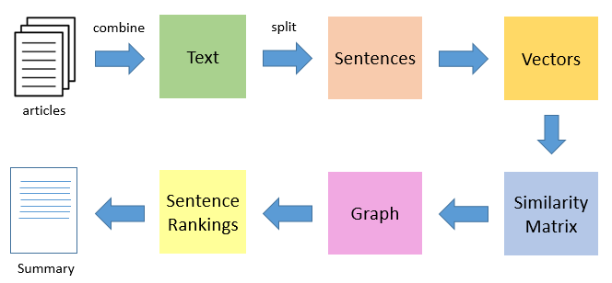
TextRank Summarization(con’t)
The first step would be to concatenate all the text contained in the articles
Then split the text into individual sentences
In the next step, we will find vector representation (word embeddings) for each and every sentence
Similarities between sentence vectors are then calculated and stored in a matrix
The similarity matrix is then converted into a graph, with sentences as vertices and similarity scores as edges, for sentence rank calculation
Finally, a certain number of top-ranked sentences form the final summary

Slide 11
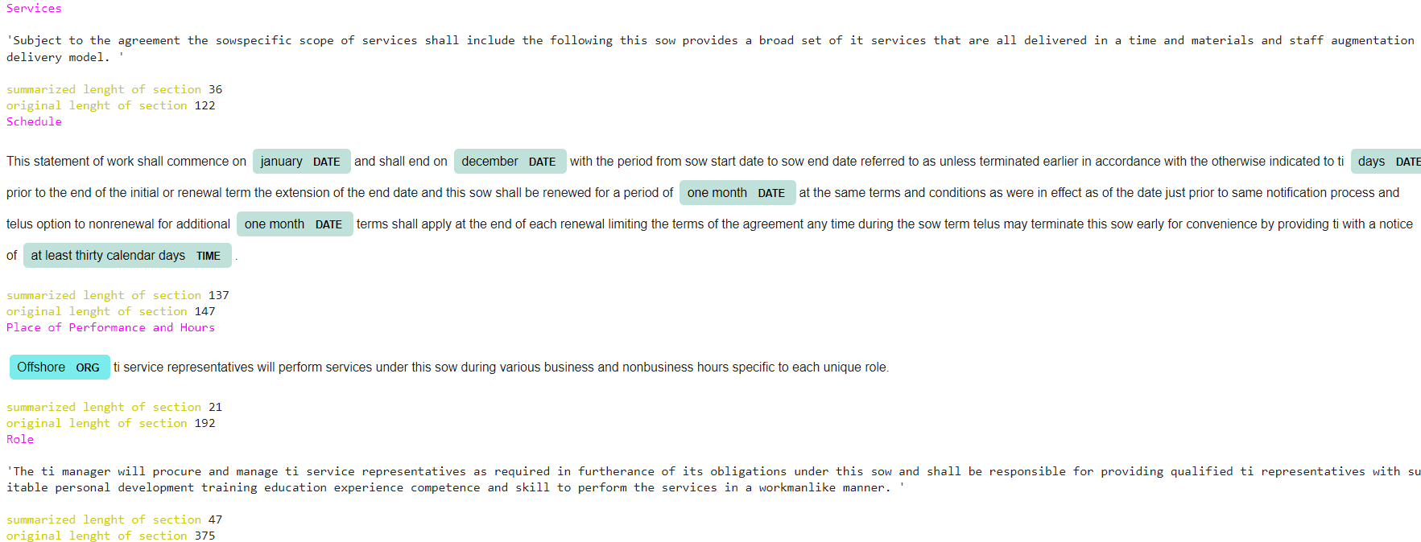
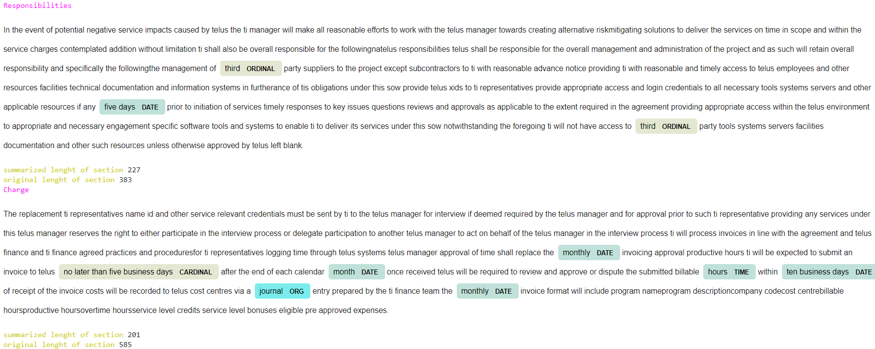
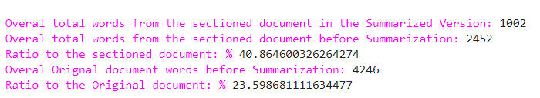
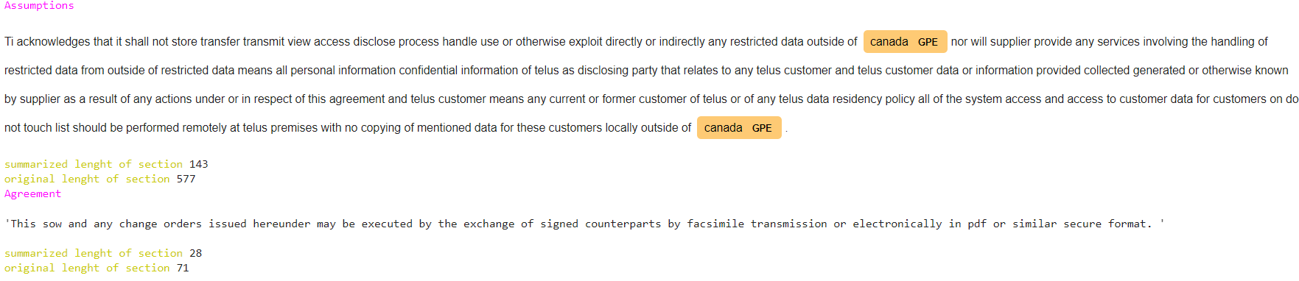
TextRank Summarization
Section by Section Summarization
Sample Document: TI_SOW_58_2019_TM_MITS_Stratus_mock.docx

Slide 12
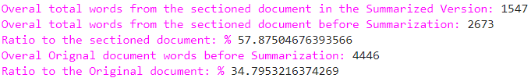
TF-IDF Summarization
Section by Section Summarization
Sample Document: TI_SOW_58_2019_TM_MITS_Stratus_mock.docx

Slide 13

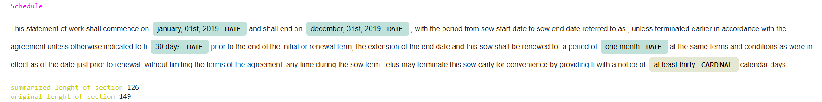
TF-IDF: (Summary Results)
Sample Document: TI_SOW_58_2019_TM_MITS_Stratus_mock.docx
Section: Schedule
TF-IDF Summary:

Slide 14
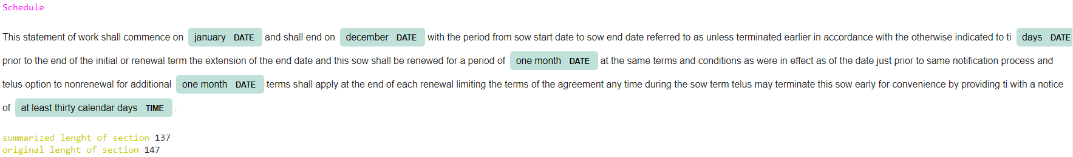
TEXTRANK : (Summary Results)
Sample Document: TI_SOW_58_2019_TM_MITS_Stratus_mock.docx
Section: Schedule
TEXTRANK Summary:

Slide 15
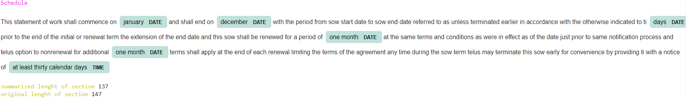
LSA Summary Results:
LSA Summary:

Slide 16
Abstractive Summarization Using BART and T5 Transformers

Slide 17
Sequence-to-sequence (seq2seq) models in NLP are used to convert sequences of Type A to sequences of Type B. For example, translation of German sentences to English sentences is a sequence-to-sequence task.
These sequence-to-sequence models are pretty versatile and they are used in a variety of NLP tasks, such as:
Machine Translation
Text Summarization
Question-Answering System, and so on
What are Sequence to sequence (seq2seq) Models ?

Slide 18
Sequence to Sequence Examples
For Seq2Seq Networks (RNN(1982), LSTM (1997)) , the input data needs to be passed sequentially one after the other. We need inputs of the previous state to make any operations on the current state. As such, sequential flow does not make use of today's GPUs very well which are designed for parallel computation
Notes:
Let’s take a simple example of a sequence-to-sequence model
The above seq2seq model is converting a German phrase to its English counterpart
When you feed an Encoder a Text it Vectorizes it
Decoder Translates the output vector in to Text
Both Encoder and Decoder have recurrent layers
At every time step in the Encoder, the RNN takes a word vector (xi) from the input sequence and a hidden state (Hi) from the previous time step
The hidden state is updated at each time step
The hidden state from the last unit is known as the context vector. This contains information about the input sequence
This context vector is then passed to the decoder and it is then used to generate the target sequence (English phrase)
The sequential nature of the model architecture does not make use of today's GPUs very well which are
designed for parallel computation

Slide 19
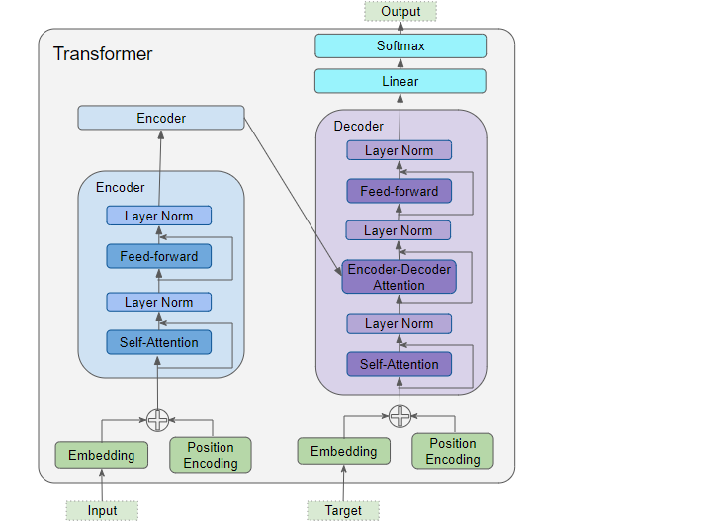
Transformers
Introduced in 2017
Notes:
Transformer is an architecture for transforming one sequence into another one with the help of two parts (Encoder and Decoder), but it differs from the previously described/existing sequence-to-sequence models because it does not imply any Recurrent Networks (GRU, LSTM, etc.).
with a transformer an encoder has no concept of time step for the Input. So all the words of a sentence are inputted simultaneously

Slide 20
Transformers
Steps for both Encoders and Decoders:
Step1(Input Embedding + Positional Encoding):
The Embedding layer encodes the meaning of the word.
The Position Encoding layer represents the position of the word.
Step2 (Multi self Attention):
Captures contextual relationships between words in the sentence
Step3 (Feed Forward):
Feed-forward nets are used in practice to transform the attention vectors into a form that is digestible by the next encoder block or decoder block
Next Step for Decoder:
Step4(Softmax Layer):
Softmax is used to create a probability vector which will help us determine the final output
(e.g. predicts the next word over multiple time steps until the end of sentence token is generated).
Notes:
Since an RNN implements a loop where each word is input sequentially, it implicitly knows the position of each word.However, Transformers don’t use RNNs and all words in a sequence are input in parallel. This is its major advantage over the RNN architecture, but it means that the position information is lost, and has to be added back in separately.

Slide 21
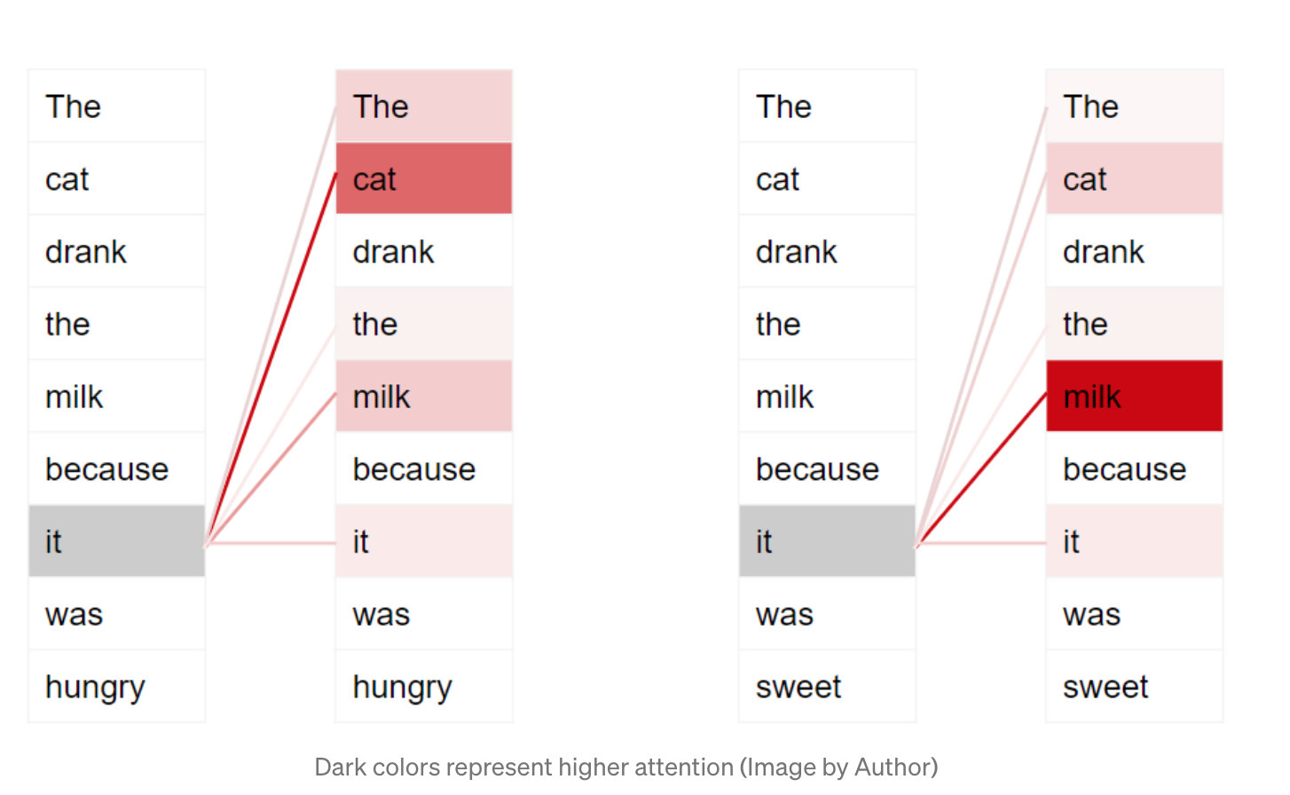
Step2 (Multi self Attention):
Reference link:
https://towardsdatascience.com/transformers-explained-visually-part-1-overview-of-functionality-95a6dd460452
Notes:
The Transformer architecture uses self-attention by relating every word in the input sequence to every other word.

Slide 22
Transformers
Steps for both Encoders and Decoders:
Step1(Input Embedding + Positional Encoding): The Embedding layer encodes the meaning of the word.
The Position Encoding layer represents the position of the word.
Step2 (Multi self Attention):
captures contextual relationships between words in the sentence
Step3 (Feed Forward):
feed-forward nets are used in practice to transform the attention vectors into a form that is digestible by the next encoder block or decoder block
Next Step for Decoder:
Step4(Softmax Layer):Softmax is used to create a probability vector which will help us determine the final output
(e.g. predicts the next word over multiple time steps until the end of sentence token is generated).
Notes:
Since an RNN implements a loop where each word is input sequentially, it implicitly knows the position of each word.However, Transformers don’t use RNNs and all words in a sequence are input in parallel. This is its major advantage over the RNN architecture, but it means that the position information is lost, and has to be added back in separately.

Slide 23
The decoder network generates the probability of occurrence of a word in the sequence. At each time step, the decoder has to make a decision as to what the next word would be in the sequence.
Parameters for Transformers
Transformer models have over 21 parameters, a few include:
1-greedy search
2-beam search
Reference link:
https://huggingface.co/transformers/main_classes/model.html
https://huggingface.co/blog/how-to-generate
Notes:
A sequence to sequence modelling network should not be used out of the box. It still needs a bit of tuning to squeeze out the best performance out there to meet expectations.
As we saw before, the decoder network generates the probability of occurrence of a word in the sequence. At each time step, the decoder has to make a decision as to what the next word would be in the sequence.
https://www.analyticsvidhya.com/blog/2018/03/essentials-of-deep-learning-sequence-to-sequence-modelling-with-attention-part-i/

Slide 24
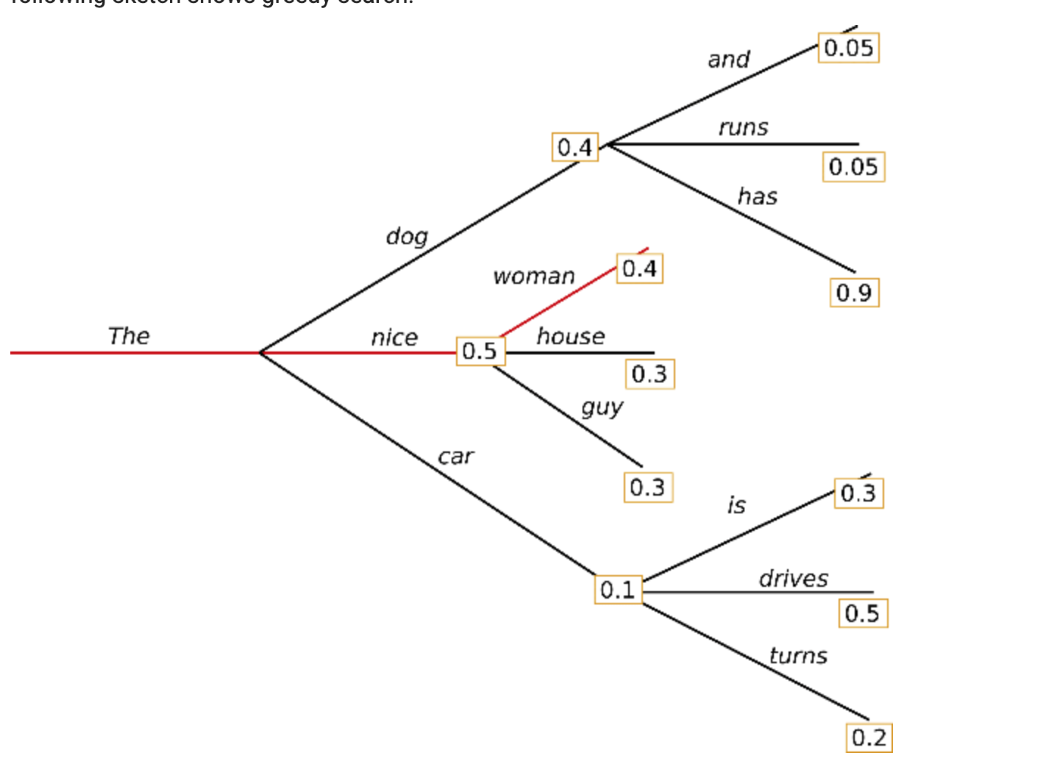
1-Greedy Search:
Greedy search simply selects the word with the highest probability as its next word
Reference link:
https://huggingface.co/blog/how-to-generate
Notes:
0.5×0.4=0.2
.

Slide 25
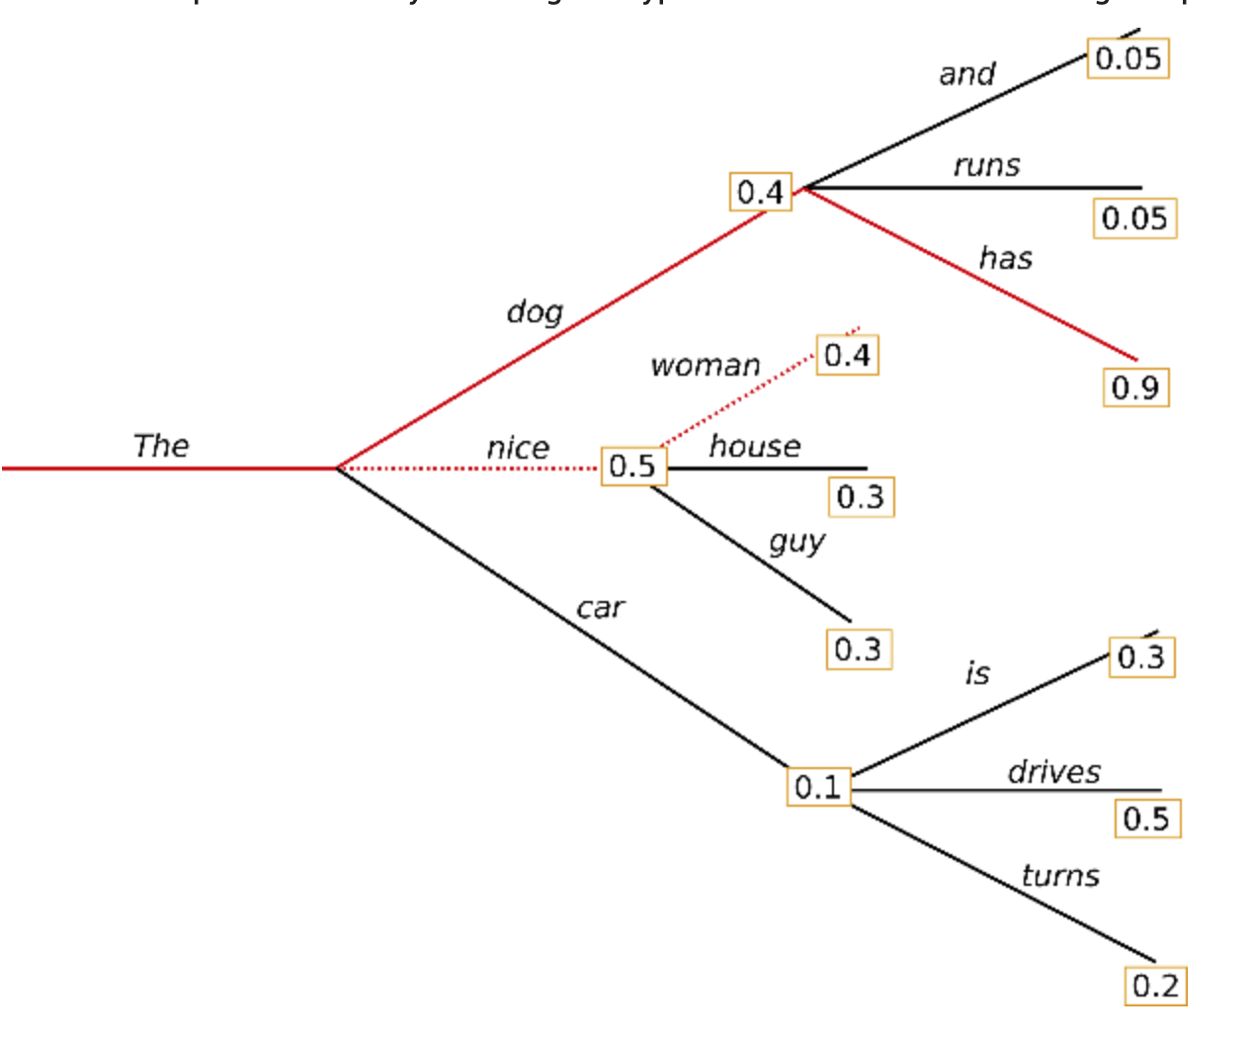
2-Beam Search:
Beam search reduces the risk of missing hidden high probability word sequences by keeping the most likely num_beams of hypotheses at each time step and eventually choosing the hypothesis that has the overall highest probability.
Let's illustrate with num_beams=2:
Reference link:
https://huggingface.co/blog/how-to-generate
Notes:
0.4*0.9=0.36

Slide 26

The BART model (Bayesian Additive Regression Trees) was presented in “BART: Denoising Sequence-to-Sequence Pre-training for Natural Language Generation, Translation, and Comprehension’’ by Mike Lewis et al. 2019
BART Transformers have many pre-trained models/weights, we chose:
“facebook/bart-large-cnn”
Reference link:
https://huggingface.co/transformers/model_doc/bart.html

Slide 27
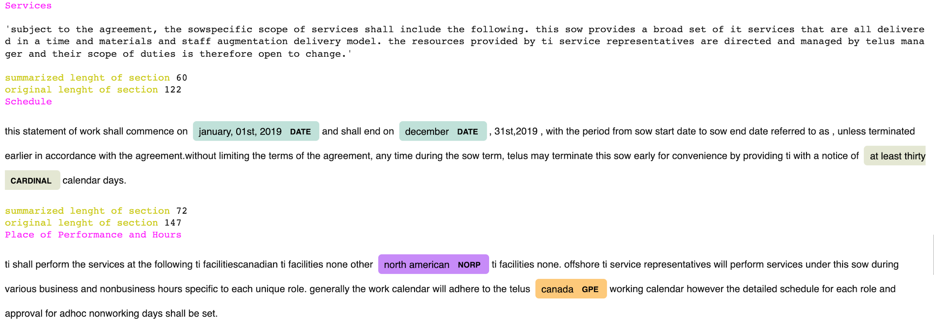
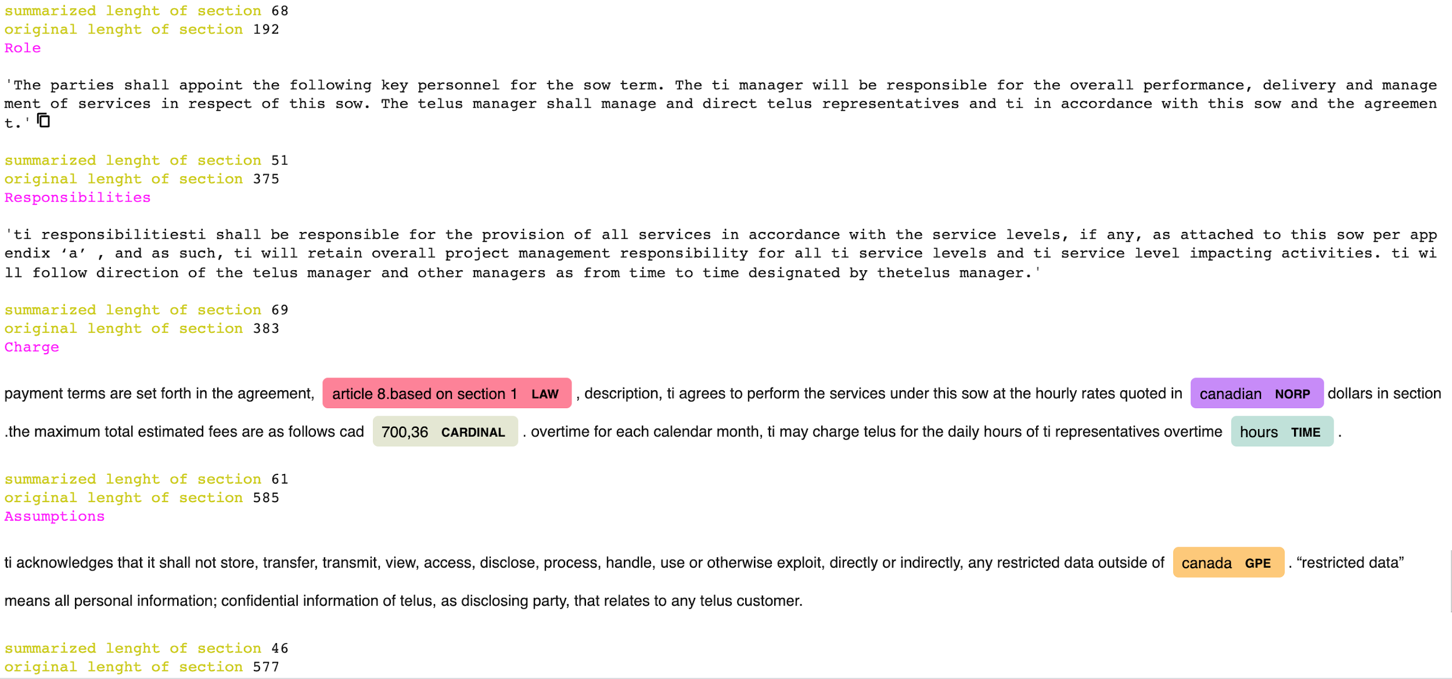
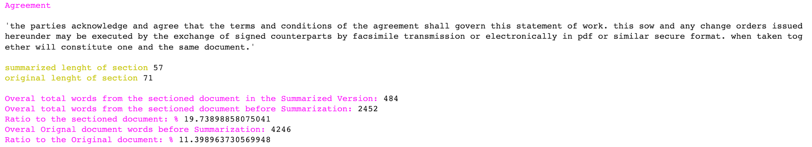
Section by Section Summarization
Sample Document: TI_SOW_58_2019_TM_MITS_Stratus_mock.docx

Slide 28
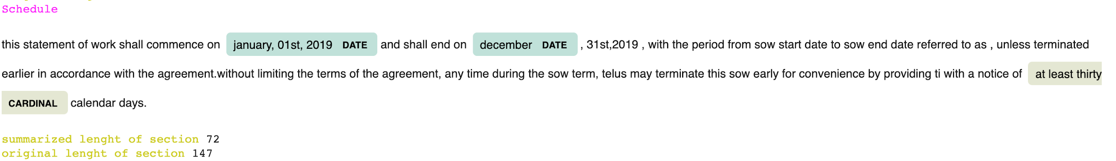
Sample Document: TI_SOW_58_2019_TM_MITS_Stratus_mock.docx
Section: Schedule
BART_Generic parameters

Slide 29
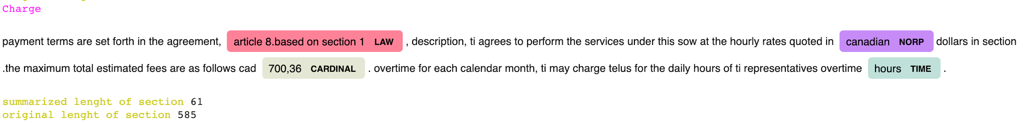
Sample Document: TI_SOW_58_2019_TM_MITS_Stratus_mock.docx
Section: Charge
BART_Generic parameters

Slide 30
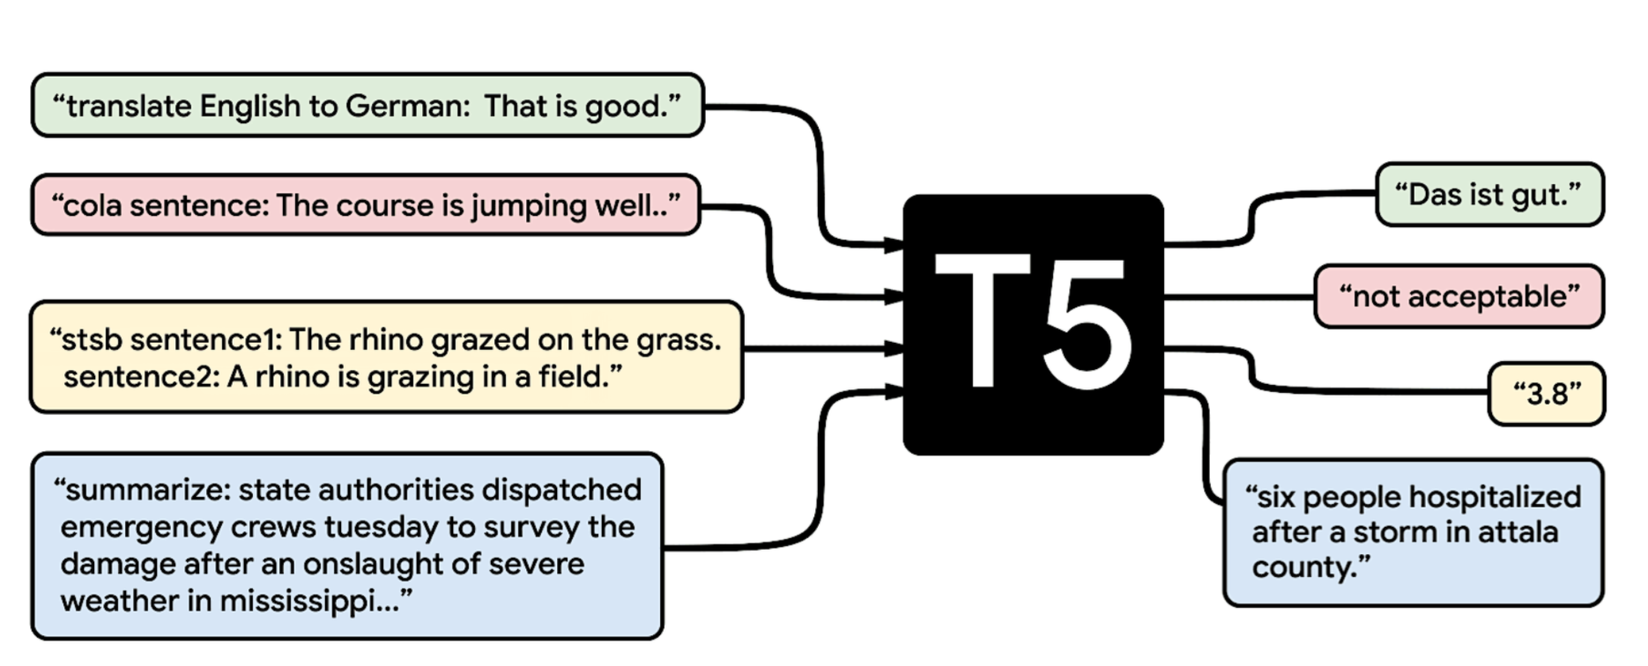
The T5 model (Text-to-Text Transfer Transformer) was presented in
"Exploring the Limits of Transfer Learning with a Unified Text-to-Text Transformer" by Colin Raffel et al. 2019
T5 Transformers have many pre-trained models/weights, we chose:
"T5-small" since it was computationally faster
Reference link: https://ai.googleblog.com/2020/02/exploring-transfer-learning-with-t5.html

Slide 31
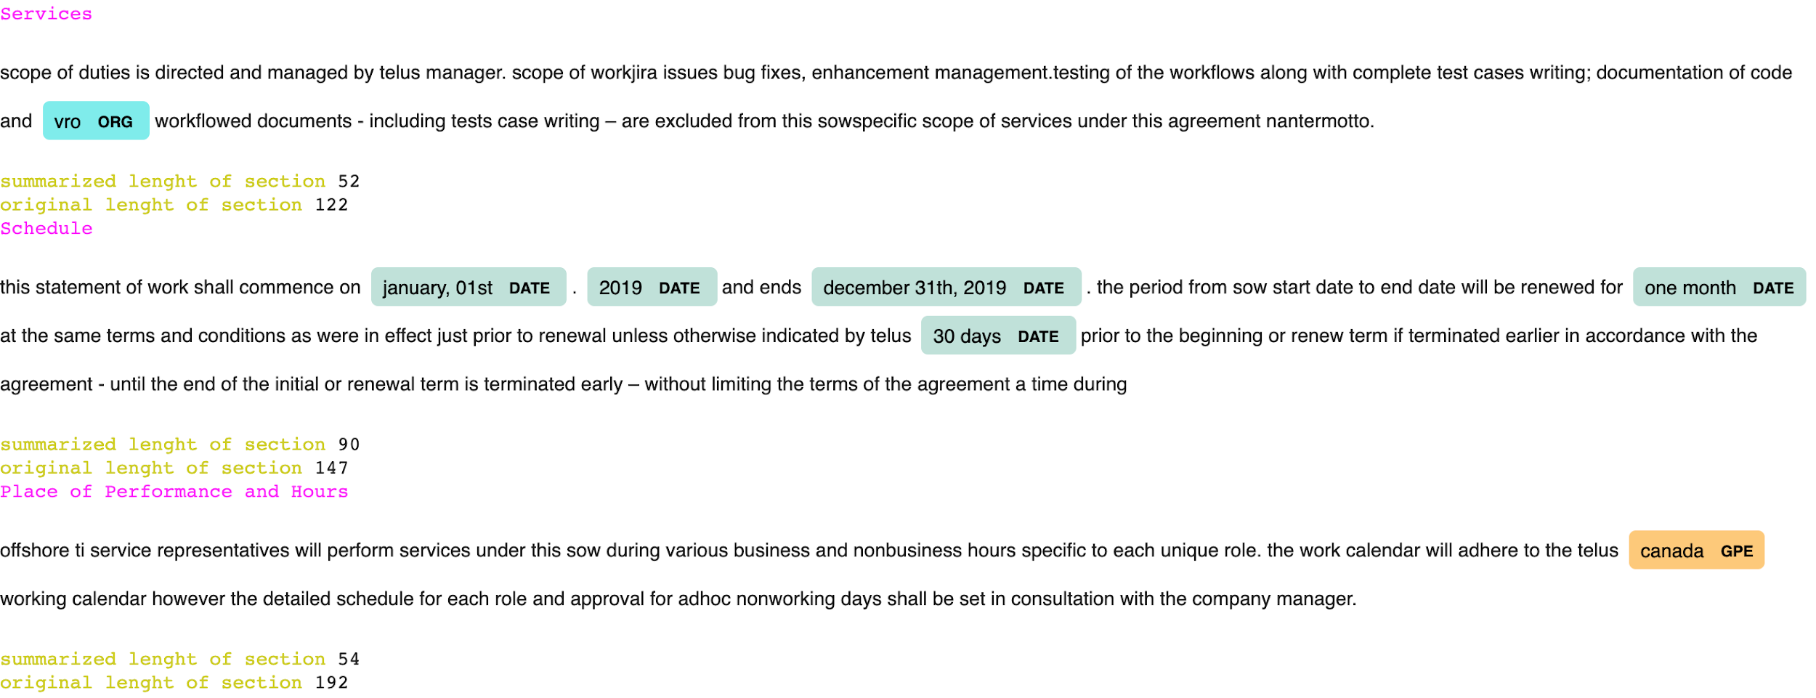

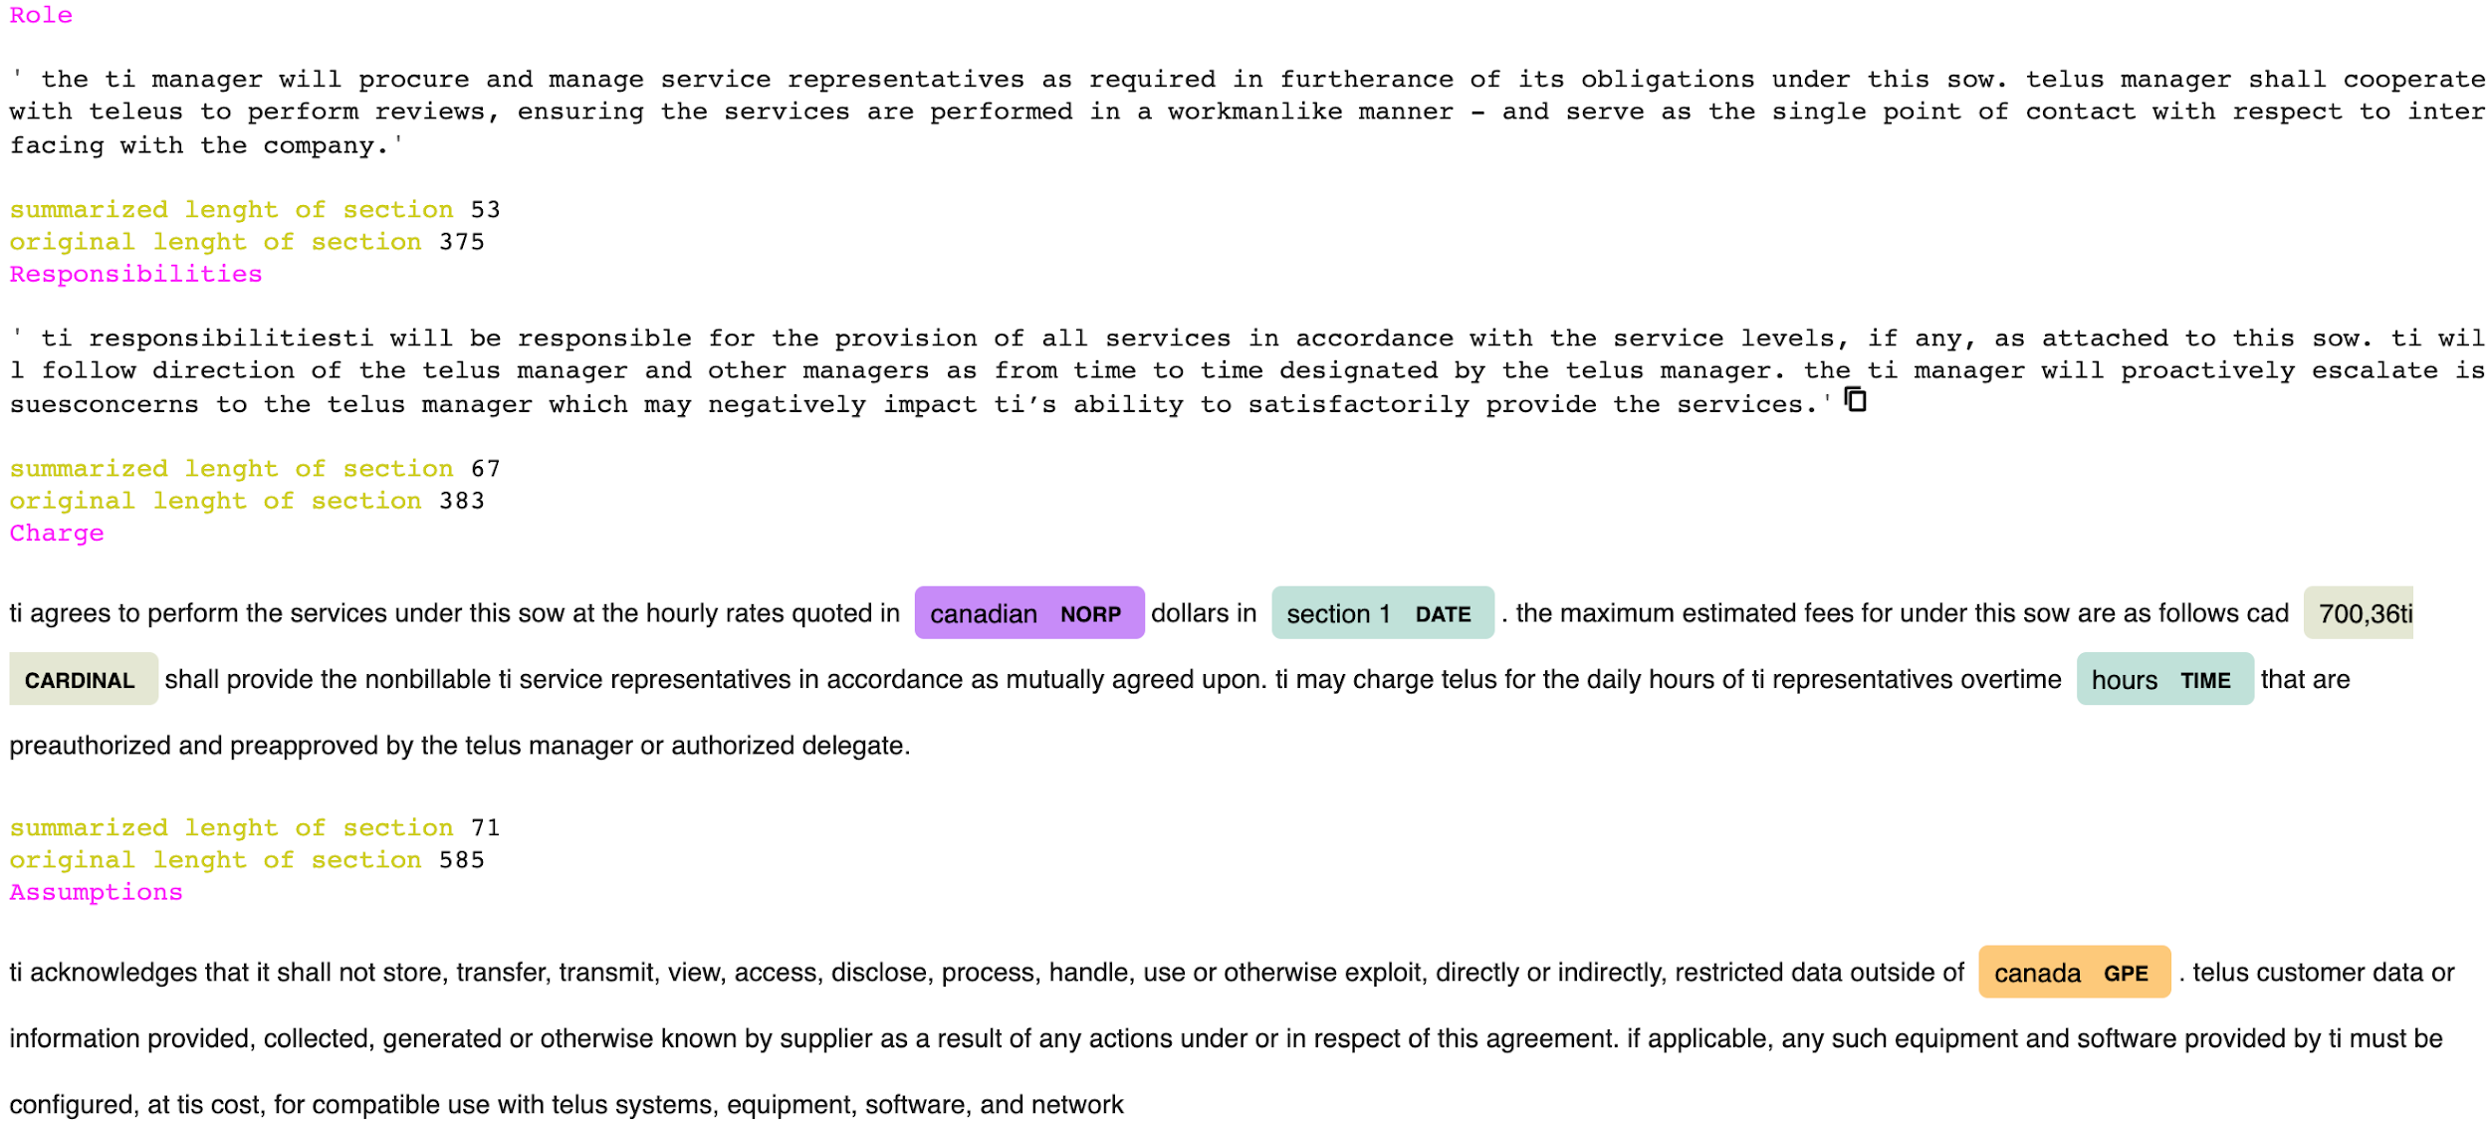
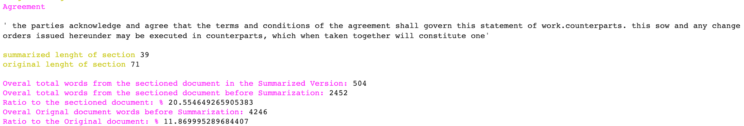
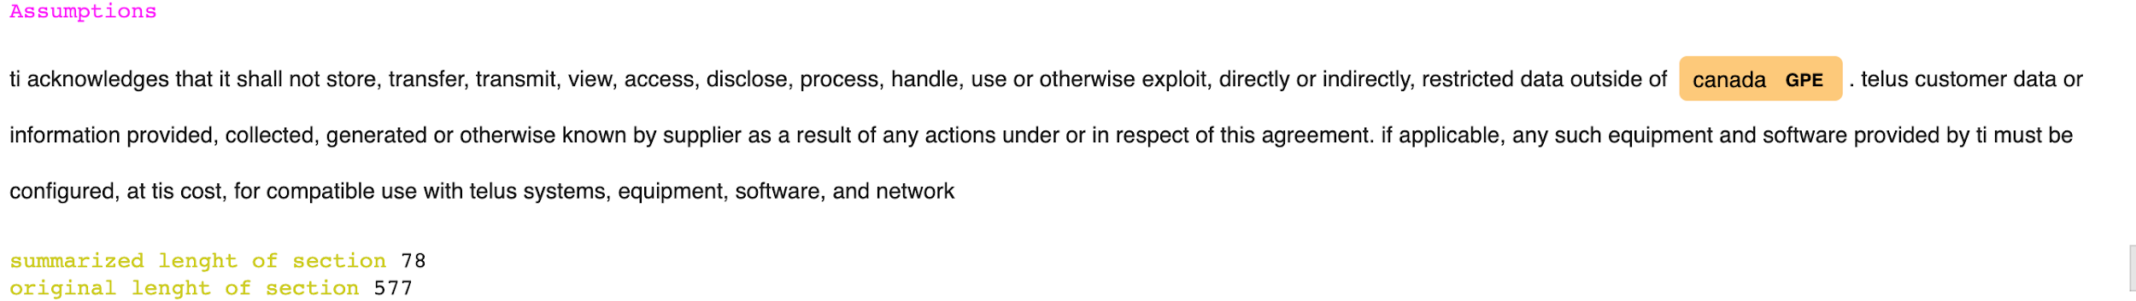
Section by Section Summarization
Sample Document: TI_SOW_58_2019_TM_MITS_Stratus_mock.docx

Slide 32
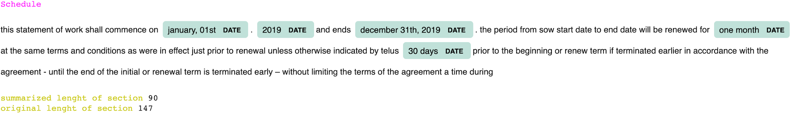
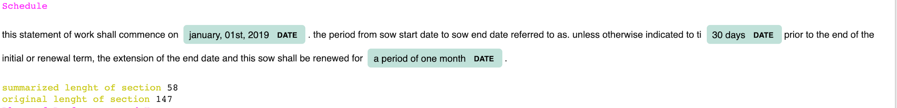
Sample Document: TI_SOW_58_2019_TM_MITS_Stratus_mock.docx
Section: Schedule
T5_customized parameters
T5_Generic parameters

Slide 33
Sample Document: TI_SOW_58_2019_TM_MITS_Stratus_mock.docx
Section: Schedule
T5_customized parameters
T5_Generic parameters
BART_Generic parameters

Slide 34
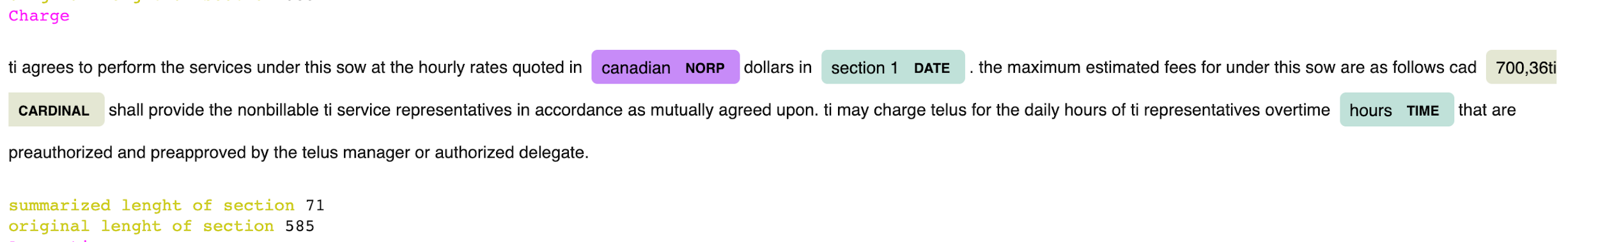
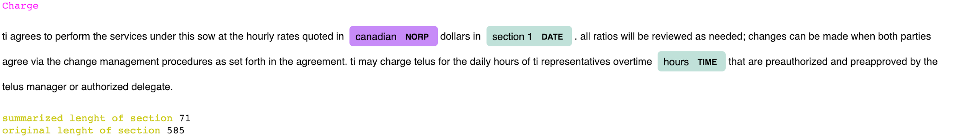
Sample Document: TI_SOW_58_2019_TM_MITS_Stratus_mock.docx
Section: Charge
T5_customized parameters
T5_Generic parameters
BART_Generic parameters

Slide 35
Challenges and Lessons Learned During Execution
Challenges:
Finding the optimal combination of content from the Project Sow document to use, to obtain meaningful insights for summarization. Going over all the documents and evaluating how are summarization models/Algo’s capturing information from them.
What data cleaning steps to execute (Did not remove all punctuations)
Deciding which sections are most informative.
Understanding the property of each parameter for both Extractive and Abstractive models
Lessons Learned:
Garbage in will be Garbage out

Slide 36
Thank You
Any Questions??

